Slide 1

50.039 Theory and Practice of Deep Learning W12-S2 About Diffusion Models
Matthieu De Mari

Slide 2
About this week (Week 12, an informative lecture about diffusion models)
What is a Stochastic Differential Equation?
What are typical uses of SDEs?
Can I noise images progressively using SDEs?
Can you train a denoising autoencoder model that removes SDE noise from images?
What is the diffusion process and how to use it to train diffusion models?
What are the architectures of DALL-E and Midjourney models?

Slide 3
Diffusion Models: a definition
Definition (Diffusion Models):
Diffusion models are a class of stochastic mathematical models that have typically been used to describe the random motion of particles, often referred to as “Brownian motion.“
They are widely used in various fields, such as physics, chemistry, biology, and finance, for instance to model the stochastic behaviour of particles or other quantities that exhibit random fluctuations over time.
The fundamental concept behind diffusion models is the idea of Stochastic Differential Equations (SDEs).

Slide 4
Stochastic Differential Equations (SDEs)
Definition (Stochastic Differential Equations):
Stochastic Differential Equations (SDEs) are differential equations where one or more of the terms include a random component, usually in the form of a noise term.
The randomness is often modelled using a Wiener process or Brownian motion, which is a continuous-time stochastic process characterized by a mean, a variance, and independent increments.

Slide 5
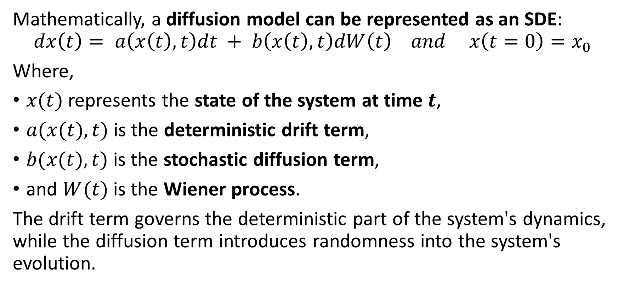
Diffusion models as SDEs
Mathematically, a diffusion model can be represented as an SDE:
$$dx\left(t\right)= a\left(x\left(t\right), t\right)dt + b\left(x\left(t\right), t\right)dW\left(t\right) and x\left(t=0\right)=x_{0}$$
Where,
$x(t)$represents the state of the system at time $t$,
$a(x(t), t)$is the deterministic drift term,
$b(x(t), t)$is the stochastic diffusion term,
and $W(t)$is the Wiener process.
The drift term governs the deterministic part of the system's dynamics, while the diffusion term introduces randomness into the system's evolution.

Slide 6
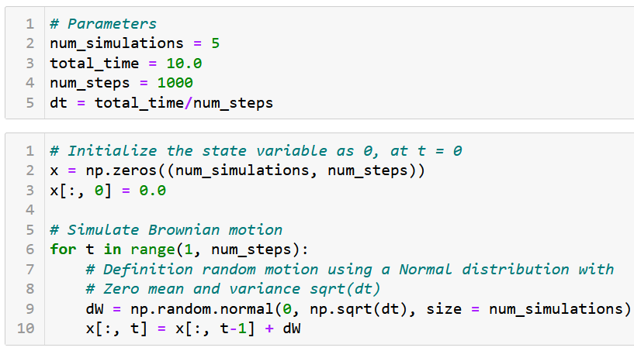
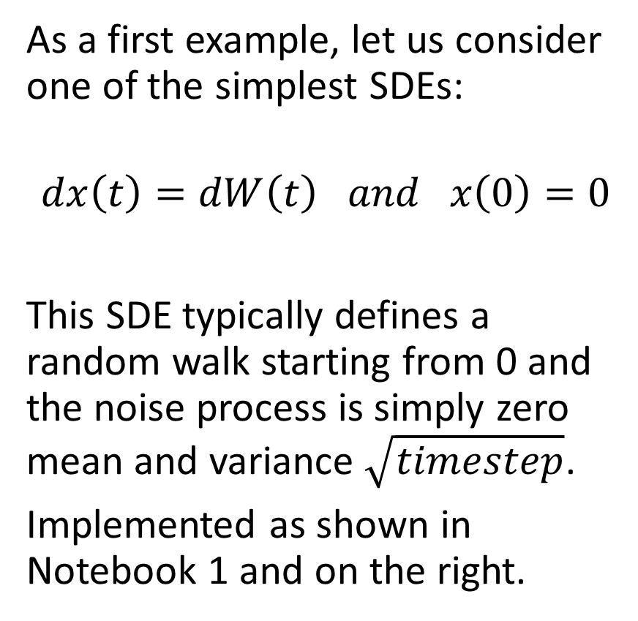
A first SDE: the Brownian motion
As a first example, let us consider one of the simplest SDEs:
$$dx\left(t\right)=dW\left(t\right) and x\left(0\right)=0$$
This SDE typically defines a random walk starting from 0 and the noise process is simply zero mean and variance $\sqrt{timestep}$.
Implemented as shown in Notebook 1 and on the right.

Slide 7
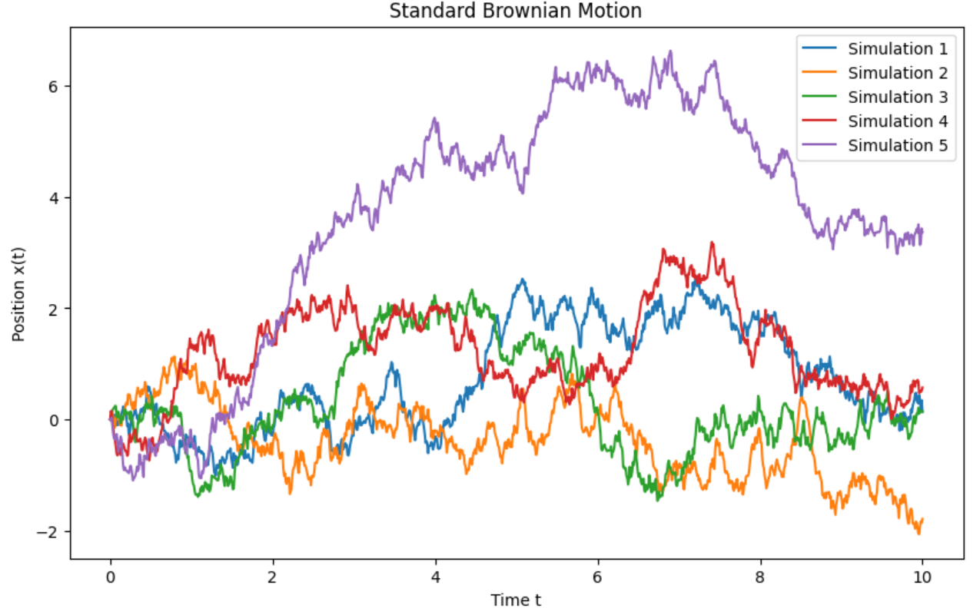
A first SDE: the Brownian motion
As a first example, let us consider one of the simplest SDEs:
$$dx\left(t\right)=dW\left(t\right) and x\left(0\right)=0$$
This SDE typically defines a random walk starting from 0 and the noise process is simply zero mean and variance $\sqrt{timestep}$.
Implemented as shown in Notebook 1 and on the right.

Slide 8
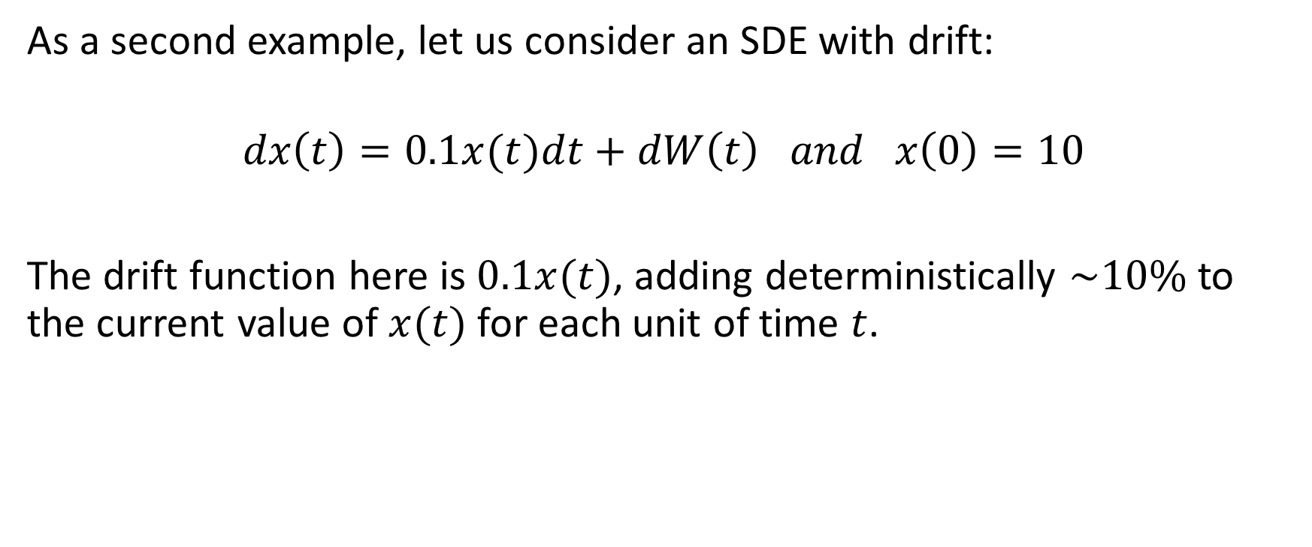
A second SDE with drift
As a second example, let us consider an SDE with drift:
$$dx\left(t\right)=0.1x(t)dt+dW\left(t\right) and x\left(0\right)=10$$
The drift function here is $0.1x(t)$, adding deterministically $\sim 10\%$to the current value of $x(t)$for each unit of time $t$.

Slide 9
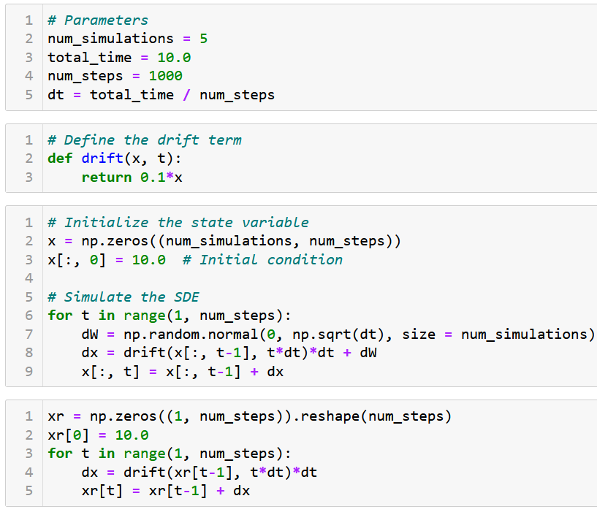
A second SDE with drift
This second SDE is typically implemented as shown.
We also show as xr, the realisation of the SDE without any Wiener motion.

Slide 10
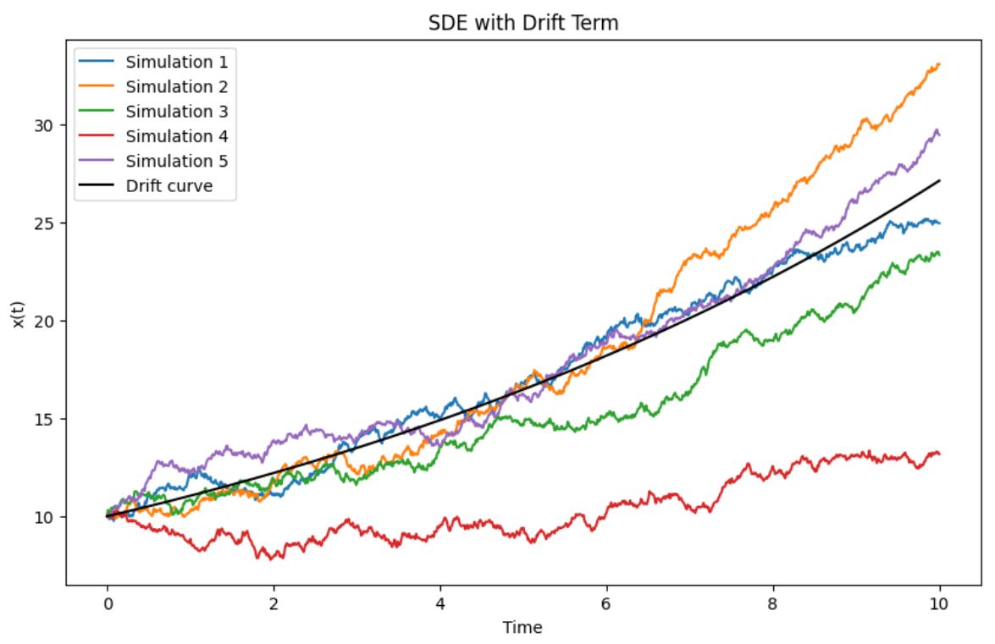
A second SDE with drift
This second SDE is typically implemented as shown.
We also show as xr, the realisation of the SDE without any Wiener motion.
Typically a 10% increase per unit of time (as is often described the US stock market), with noisy variations.
Is the stock market an SDE of some sort then?

Slide 11
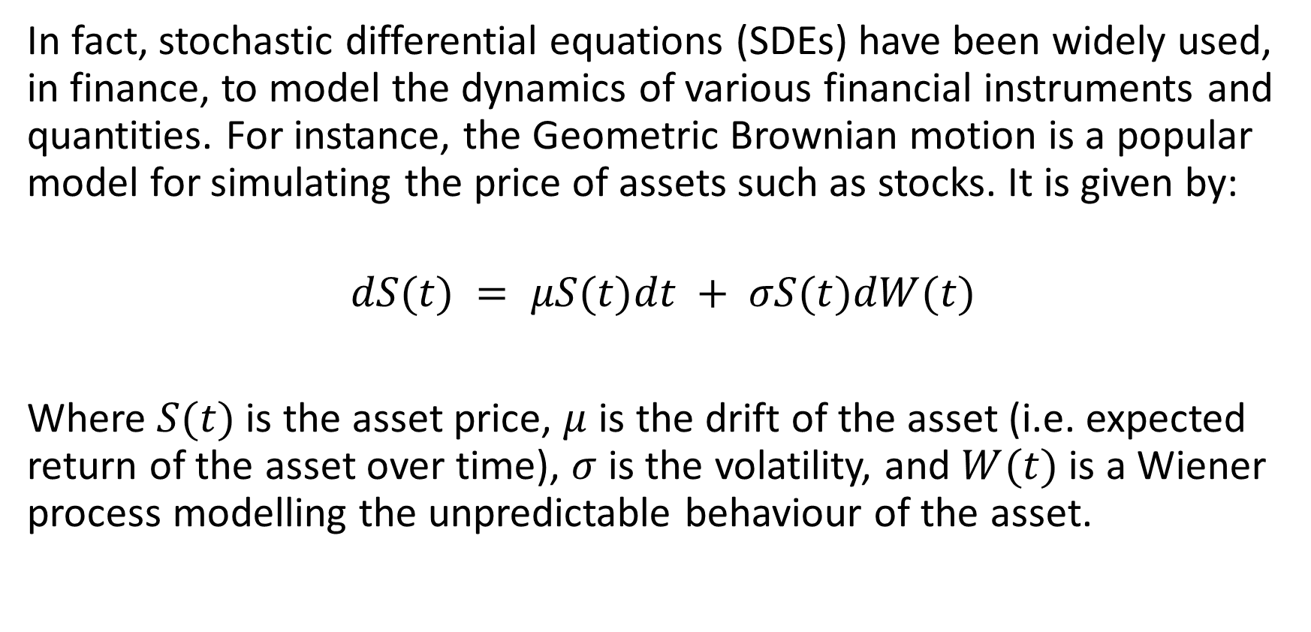
Typical examples of SDEs
In fact, stochastic differential equations (SDEs) have been widely used, in finance, to model the dynamics of various financial instruments and quantities. For instance, the Geometric Brownian motion is a popular model for simulating the price of assets such as stocks. It is given by:
$$dS(t) = μS(t)dt + σS(t)dW(t)$$
Where $S(t)$is the asset price, $μ$ is the drift of the asset (i.e. expected return of the asset over time), $σ$ is the volatility, and $W(t)$is a Wiener process modelling the unpredictable behaviour of the asset.

Slide 12
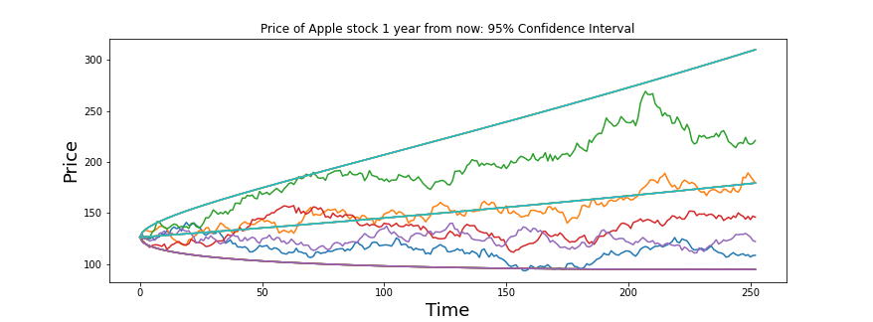

Typical examples of SDEs
In fact, stochastic differential equations (SDEs) have been widely used, in finance, to model the dynamics of various financial instruments and quantities. For instance, the Geometric Brownian motion is a popular model for simulating the price of assets such as stocks. It is given by:
$$dS(t) = μS(t)dt + σS(t)dW(t)$$
Where $S(t)$is the asset price, $μ$ is the drift of the asset (i.e. expected return of the asset over time), $σ$ is the volatility, and $W(t)$is a Wiener process modelling the unpredictable behaviour of the asset.

Slide 13
A first task, denoising images
Let us start by defining the four components of our ML problem.
Task: take images from MNIST and noise them. The model should try its best to denoise them an get back to the original image.
Dataset: MNIST images, noised (inputs) and original (output).
Model: an encoder-decoder model of some sort, similar to an autoencoder (almost).
Loss and training procedure: As in the case of autoencoders, a simple MSE loss and a basic training procedure with Adam optimizer will do.

Slide 14
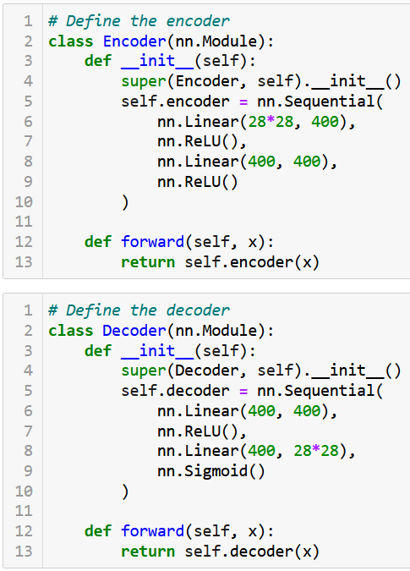
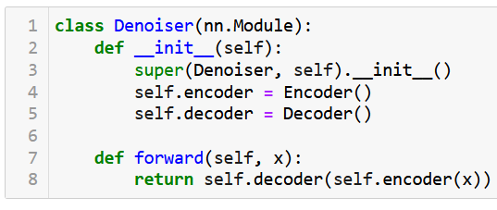
A first task, denoising images
For simplicity, we consider an encoder-decoder model, similar to our autoencoder in W10-NB1, running on linear layers.
And a basic training procedure…

Slide 15
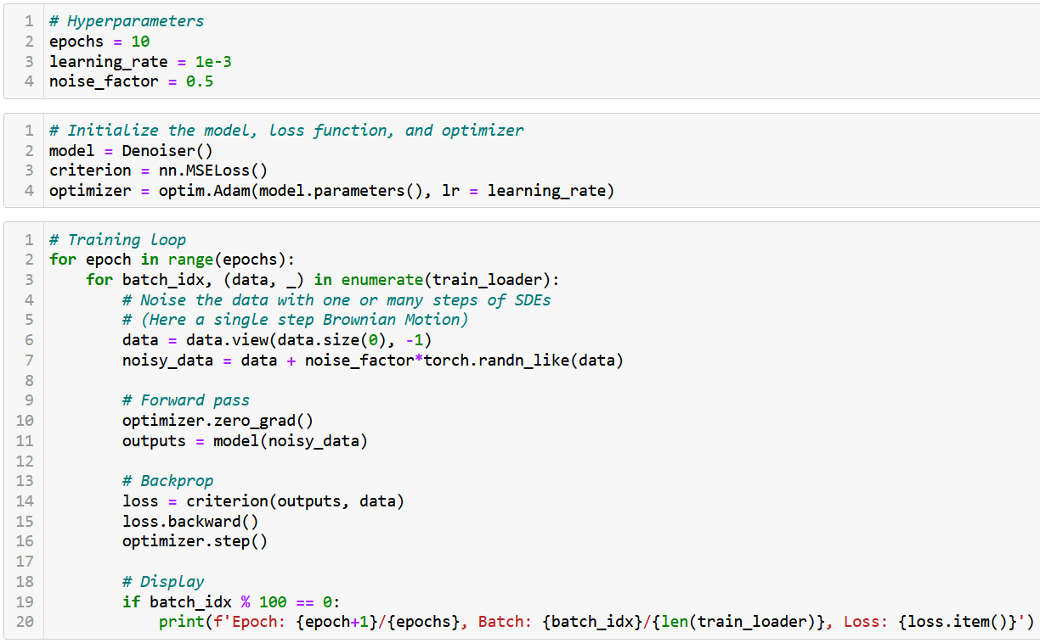

Slide 16
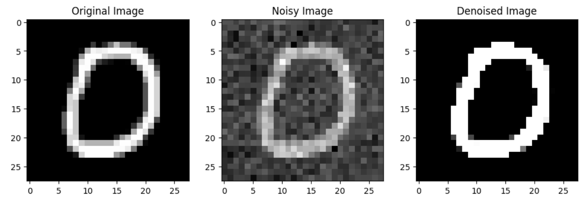
A first task, denoising images
The model trains and seems able to denoise lightly noised images.

Slide 17
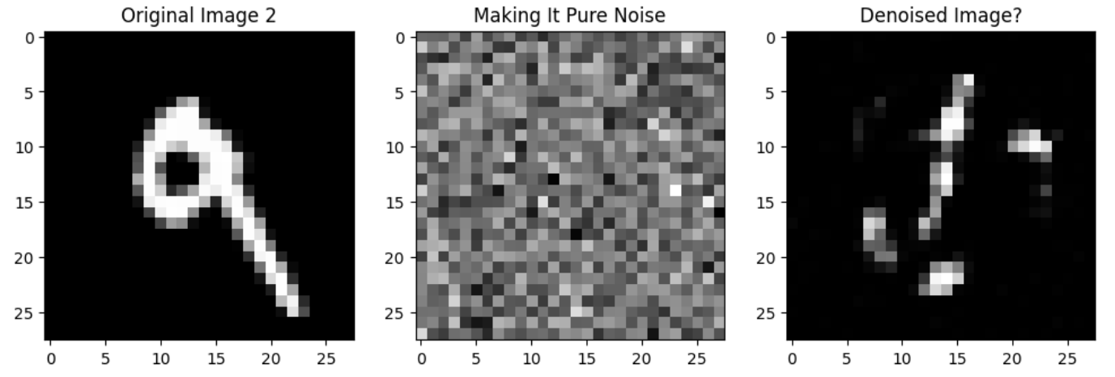
A first task, denoising images
The model trains and seems able to denoise lightly noised images.
Could it denoise a pure noise image, though? Not really.

Slide 18
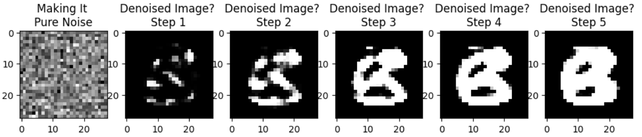
A first task, denoising images
The model trains and seems able to denoise lightly noised images.
Could it denoise a pure noise image, though? Not really.
What if we used the model many (e.g. 5) times in a row on our full noise image? Eventually would obtain something B&W in the likes of MNIST but somehow non-sensical in terms of shapes…?!

Slide 19
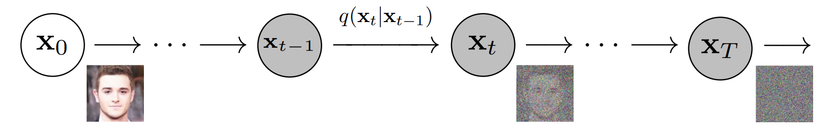
A (not so?) crazy idea
Idea: what if instead of noising the image in one step, and denoising it in one call of the model, we try iterative noising and denoising?
(Somehow similar to the idea of modifying the image iteratively during the iterated versions of our attacks in W5!)

Slide 20
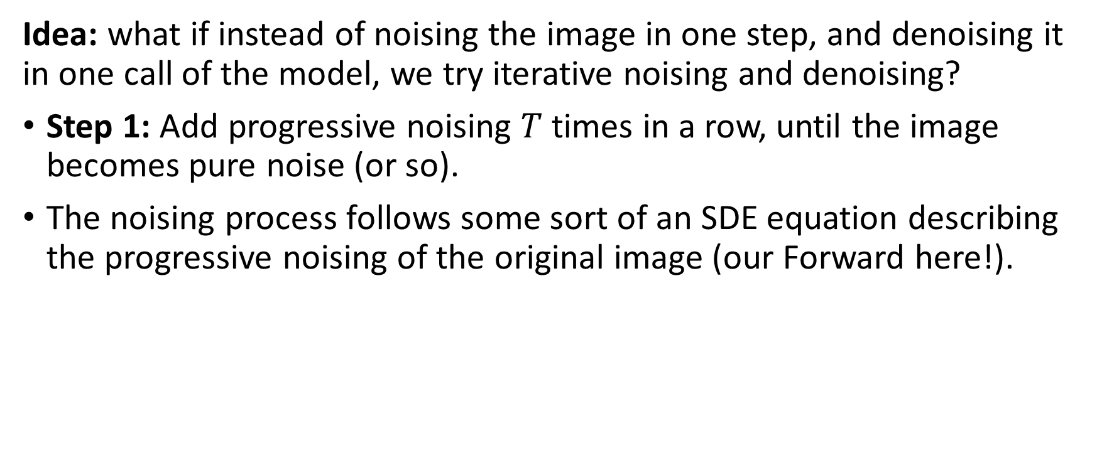
A (not so?) crazy idea
Idea: what if instead of noising the image in one step, and denoising it in one call of the model, we try iterative noising and denoising?
Step 1: Add progressive noising $T$ times in a row, until the image becomes pure noise (or so).
The noising process follows some sort of an SDE equation describing the progressive noising of the original image (our Forward here!).

Slide 21




A (not so?) crazy idea
Idea: what if instead of noising the image in one step, and denoising it in one call of the model, we try iterative noising and denoising?
Step 2: Train a single model $m$ to try and cancel noising iteratively.
Our model $m$ receives image $x_{t}$ and tries to produce $x_{t−1}$, do for each noising iteration $t$ (going backwards here!).
$$m$$
$$m$$
$$m$$

Slide 22
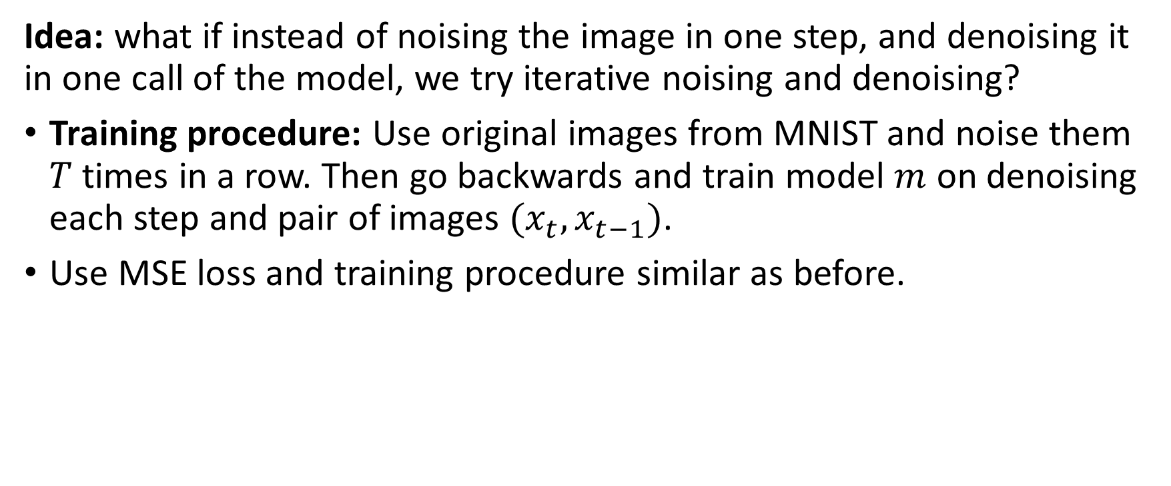
A (not so?) crazy idea
Idea: what if instead of noising the image in one step, and denoising it in one call of the model, we try iterative noising and denoising?
Training procedure: Use original images from MNIST and noise them $T$ times in a row. Then go backwards and train model $m$ on denoising each step and pair of images $(x_{t}, x_{t−1})$.
Use MSE loss and training procedure similar as before.

Slide 23
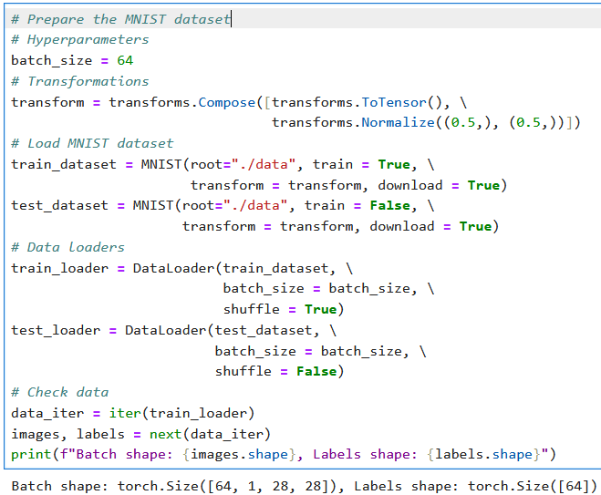
A basic Diffusion Model setup
First, we need a toy dataset.
For simplicity, we will rely on MNIST and will attempt to train a model that can generate MNIST-like images from noise.
As in previous lectures, we will prepare our dataset and dataloader objects.
Nothing particularly difficult or exciting here.

Slide 24
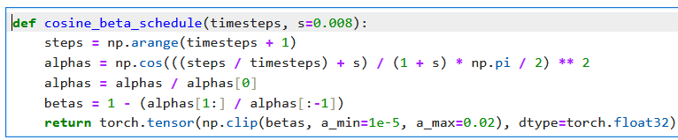
A basic Diffusion Model setup
Next, we need a noising function, whose job is to progressively add noise to MNIST images
Define a noise scheduler, have it progressively add more noise.
Cosine beta scheduler: on early timesteps, add little noise, on late timesteps, add more noise, smooth transition.

Slide 25
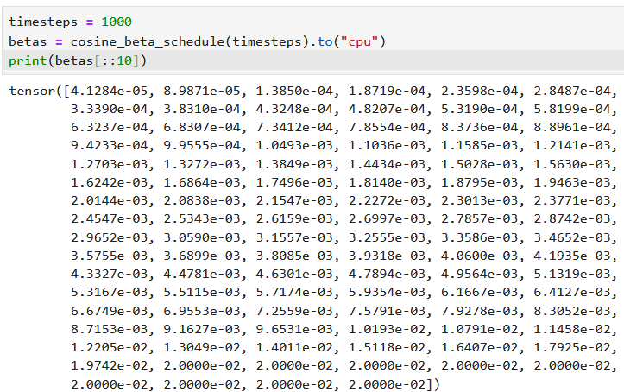
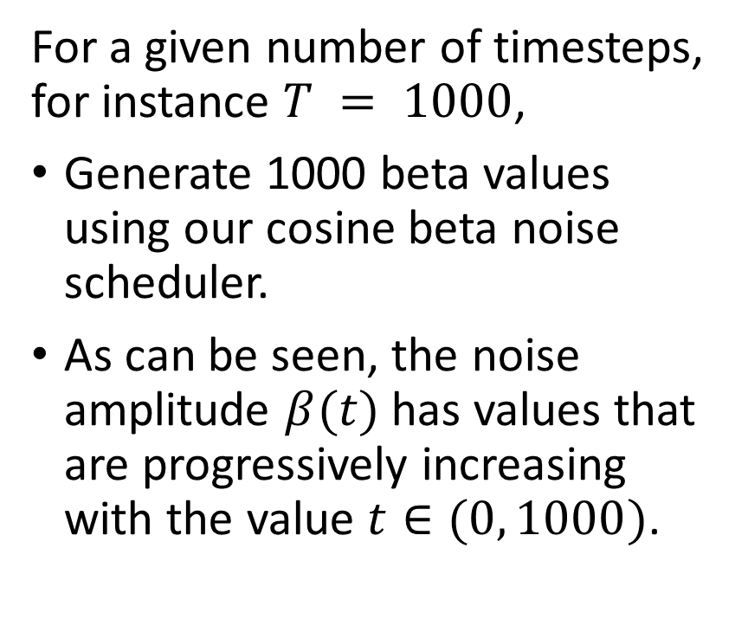
A basic Diffusion Model setup
For a given number of timesteps, for instance $T = 1000$,
Generate 1000 beta values using our cosine beta noise scheduler.
As can be seen, the noise amplitude $β(t)$ has values that are progressively increasing with the value $t∈(0, 1000)$.

Slide 26
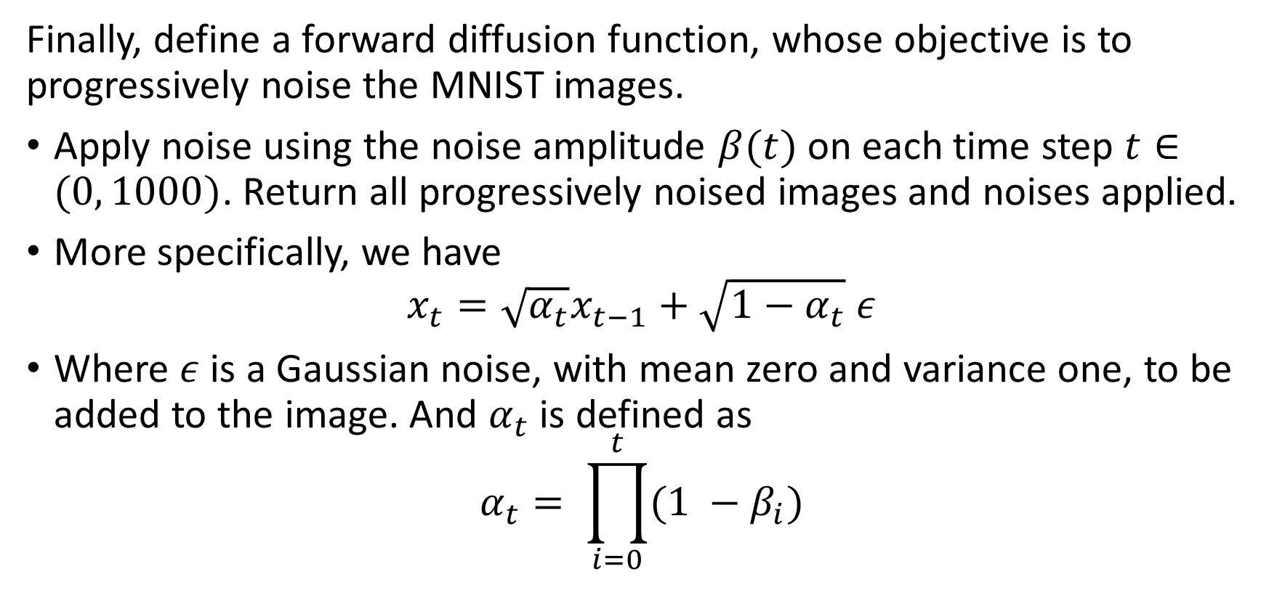
A basic Diffusion Model setup
Finally, define a forward diffusion function, whose objective is to progressively noise the MNIST images.
Apply noise using the noise amplitude $β(t)$ on each time step $t∈(0, 1000)$. Return all progressively noised images and noises applied.
More specifically, we have
$$x_{t}=\sqrt{α_{t}}x_{t−1}+\sqrt{1−α_{t}} ε$$
Where $ε$is a Gaussian noise, with mean zero and variance one, to be added to the image. And $α_{t}$ is defined as
$$α_{t}= \prod_{i=0}^{t}{(1 −β_{i})}$$

Slide 27
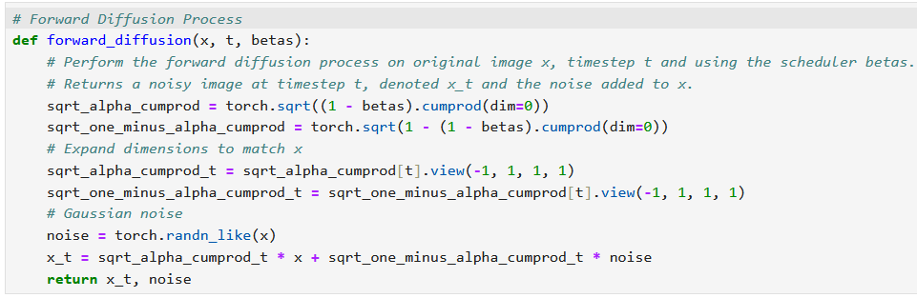

A basic Diffusion Model setup
Finally, define a forward diffusion function, whose objective is to progressively noise the MNIST images.
Apply noise using the noise amplitude $β(t)$ on each time step $t∈(0, 1000)$. Return all progressively noised images and noises applied.

Slide 28
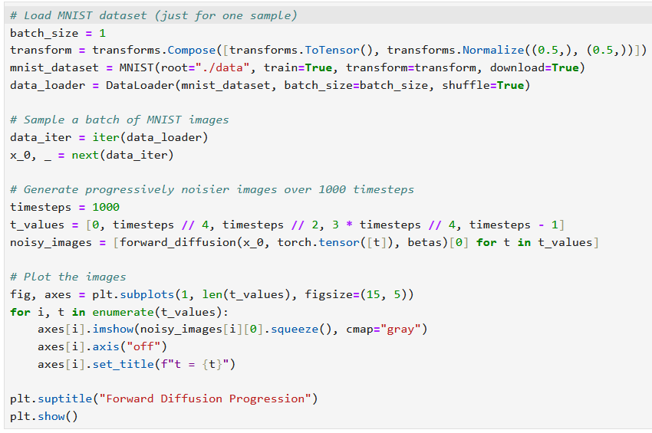
Try it on a single MNIST image!

Slide 29
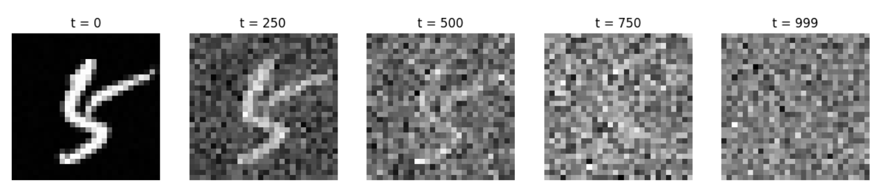
Try it on a single MNIST image!

Slide 30
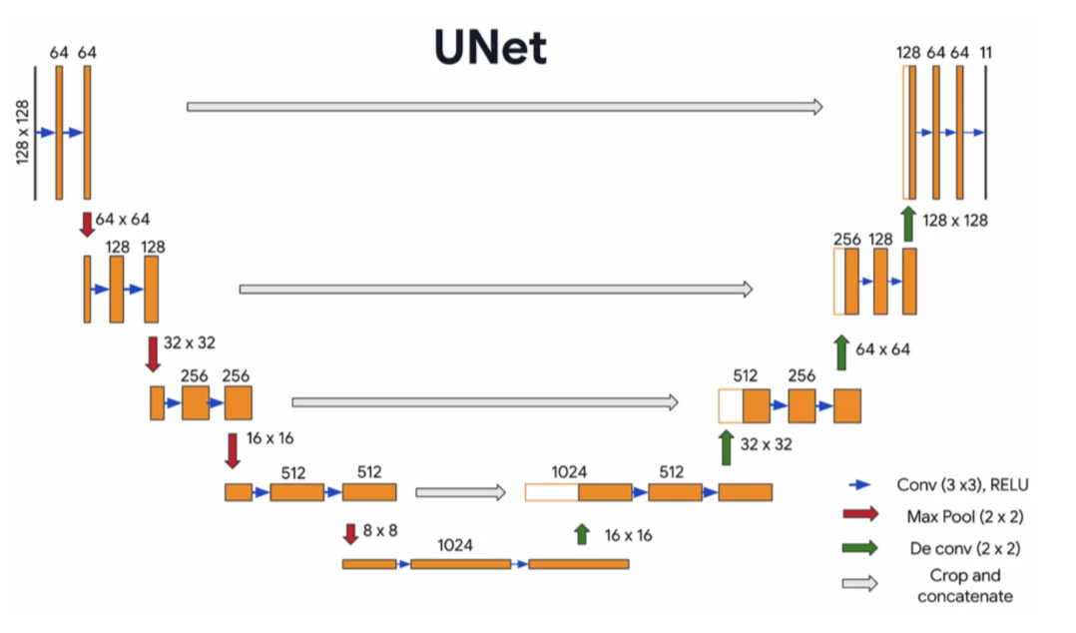
A quick word about our UNet model
For the task of denoising a noised image, we will use a UNet model.
Definition (UNet models):
A UNet is a special type of convolutional neural network (CNN) designed for image-to-image tasks, such as image segmentation, denoising, or super-resolution.
Figure: A visual representation of a UNet model.

Slide 31
A quick word about our UNet model
For the task of denoising a noised image, we will use a UNet model.
Definition (UNet models):
A UNet is a special type of convolutional neural network (CNN) designed for image-to-image tasks, such as image segmentation, denoising, or super-resolution.
Known for their U-shaped architecture, which consists of:
Encoder (Downsampling Path): Compresses the input image into a smaller representation.
Bottleneck (Middle Section): Captures high-level features.
Decoder (Upsampling Path): Reconstructs the image back to its original size while combining detailed features from the encoder.

Slide 32
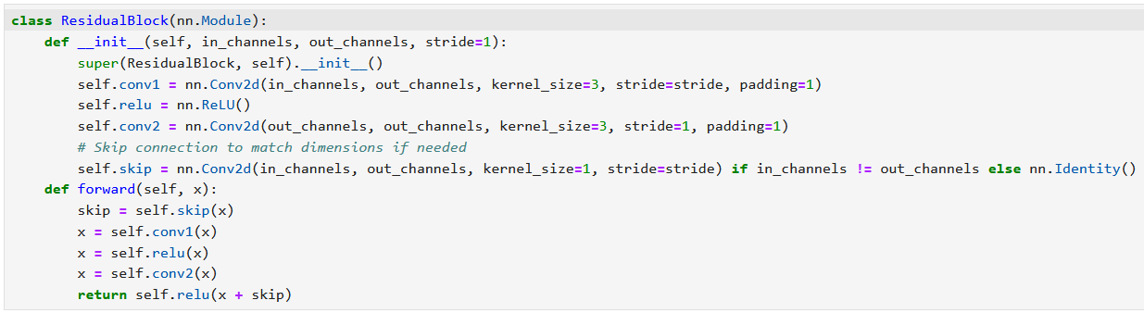
Implementing a UNet
Start by designing a residual block (works as in W4).
Magic happens in the final forward operation (x + skip).

Slide 33
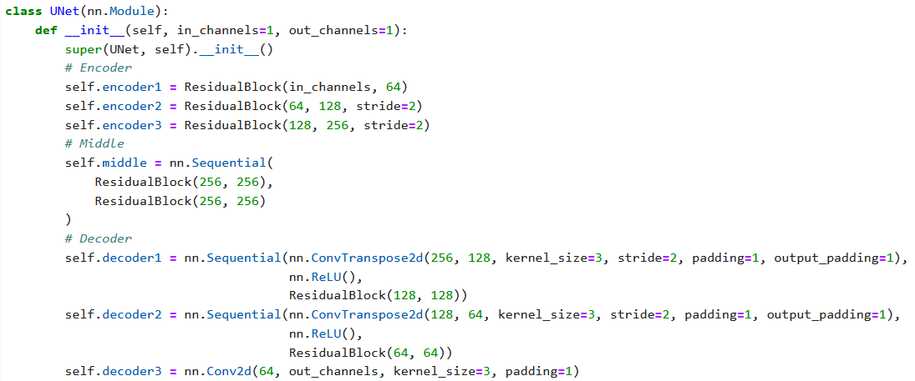
Implementing a UNet
Then, implement the three stage UNet model.

Slide 34
Implementing a UNet
Then, implement the three stage UNet model.

Slide 35
Predicting noise and denoising
Important: The purpose of the UNet model is to predict the noise added to the image, not to denoise the image directly!
Predicting the denoised image​ directly can lead to unstable training, especially when the image is heavily noised (​i.e. at high timesteps).
Noise prediction is more reliable because noise is sampled from a known Gaussian distribution, making it easier for the model to learn.
Predicting the denoised image​ directly would require the model to understand the noise distribution and the underlying image structure at once. By focusing only on the noise, the model simplifies its task.
Using the predicted noise, we calculate a "less noisy" version of the image, which is roughly equivalent.

Slide 36
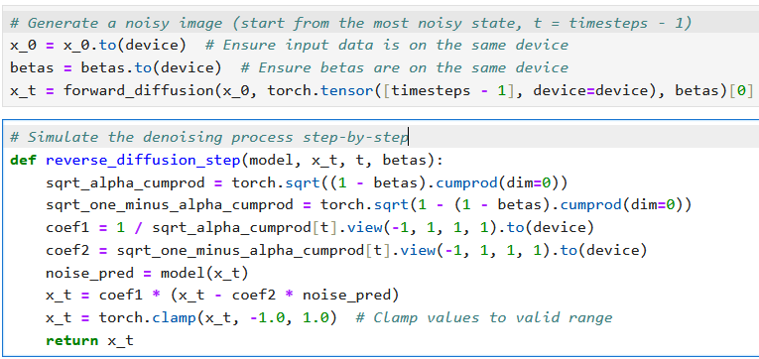
Predicting noise and denoising
Let us then define a denoising function that uses the model and progressively denoises the image using the model predictions.

Slide 37
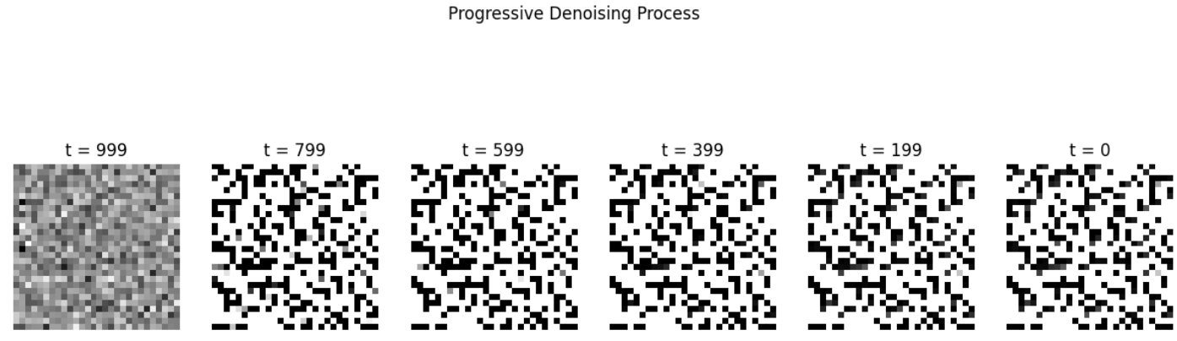
Predicting noise and denoising
At the moment, the model has not been trained, so denoising does not work well (which is expected).

Slide 38
Training the model
After initializing everything, train the model by
Noising an image drawn from MNIST over the timesteps (forward diffusion) and keep track of the noise values.
Have the model predict the noise added to each timestep.
Use MSE to compare the predicted noise and the “real” noise.
Backprop, rinse and repeat until convergence.
Using Adam and default learning rate values for simplicity.
Keep track of loss values for training curves.

Slide 39
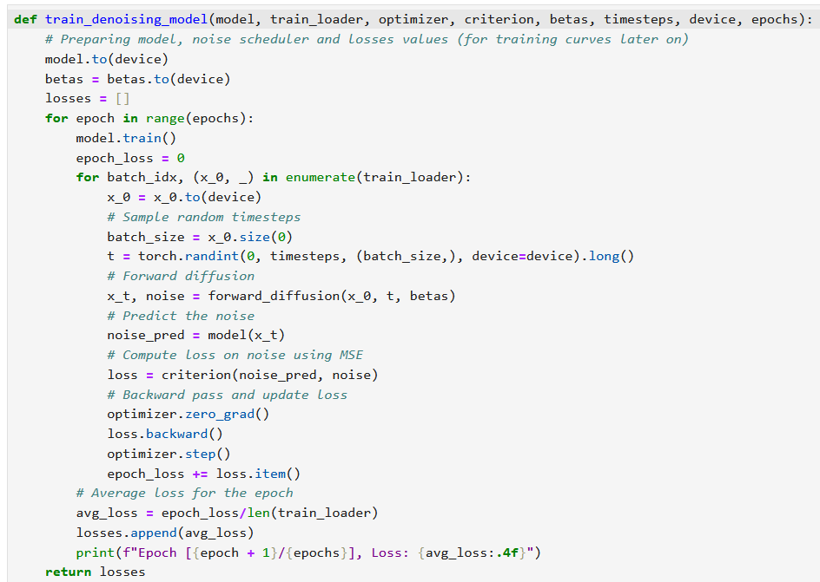
Training the model
After initializing everything, train the model by
Noising an image drawn from MNIST over the timesteps (forward diffusion) and keep track of the noise values.
Have the model predict the noise added to each timestep.
Use MSE to compare the predicted noise and the “real” noise.
Backprop, rinse and repeat until convergence.
Using Adam and default learning rate values for simplicity.
Keep track of loss values for training curves.

Slide 40
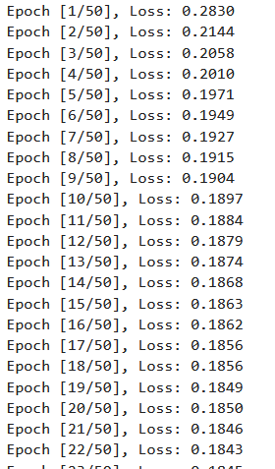
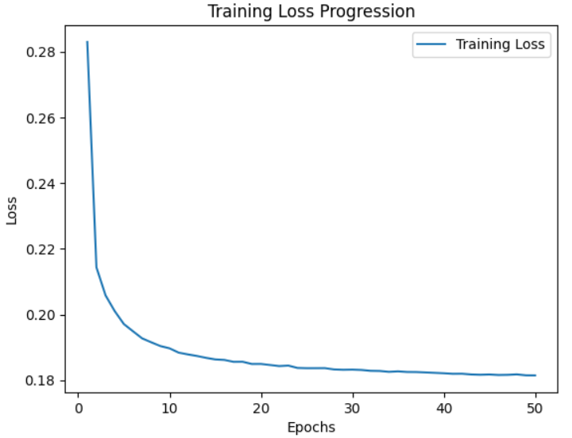
It trains?
It seems to train, although it could benefit from our arsenal of training techniques (LR decay/scheduling, using validation, etc.)

Slide 41
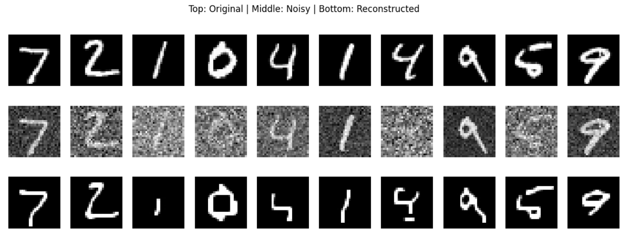
Let us visualize the results!
After training, we obtain a model that is “capable” of denoising images.

Slide 42
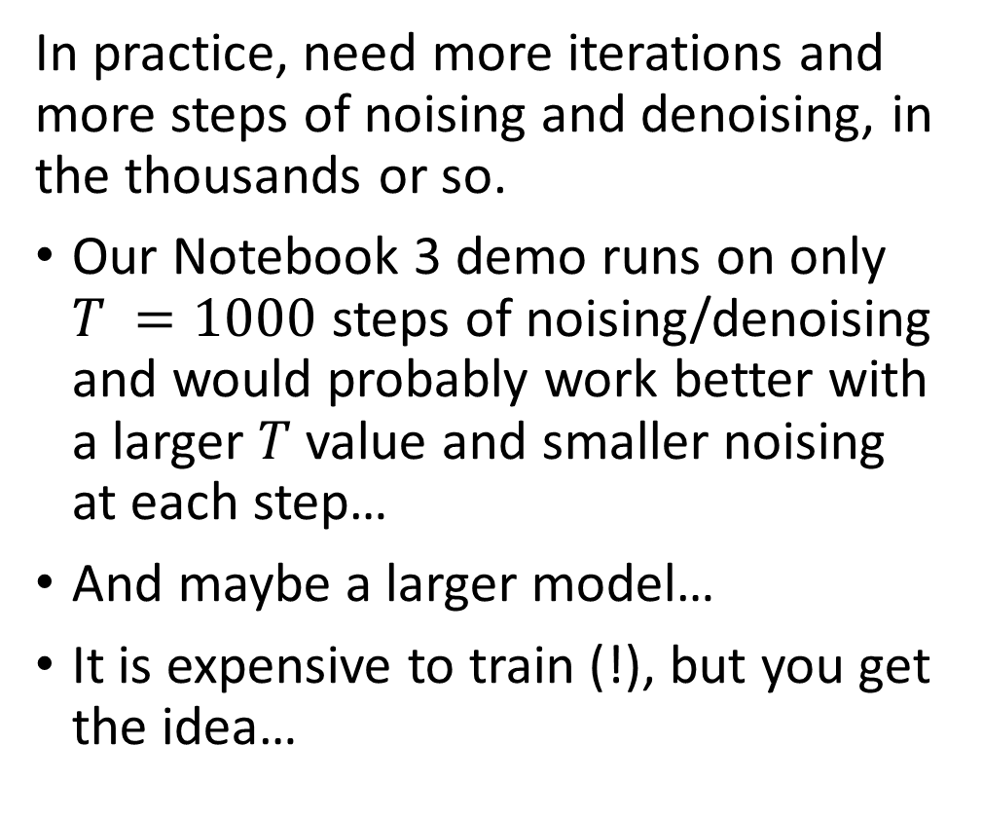
In practice, however…
In practice, need more iterations and more steps of noising and denoising, in the thousands or so.
Our Notebook 3 demo runs on only $T =1000$ steps of noising/denoising and would probably work better with a larger $T$ value and smaller noising at each step…
And maybe a larger model…
It is expensive to train (!), but you get the idea…

Slide 43
In practice, however…
We were somewhat able to train a model to denoise and eventually obtain a convincing MNIST picture from something that was close to pure noise! Another possible approach to generate images out of thin air?
Keep in mind: all advanced ideas from previous weeks are open! (using advanced layers, making it conditional like conditional GANs, cyclic, progressive, transposed conv layers, etc.)

Slide 44
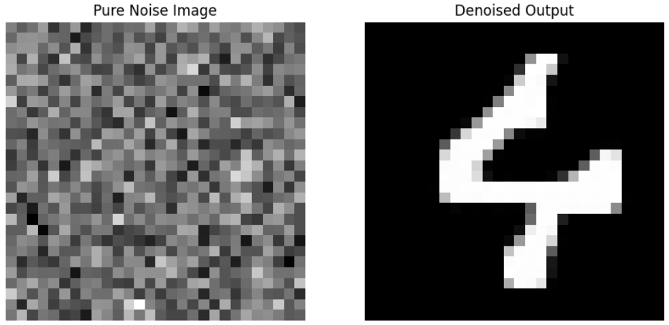
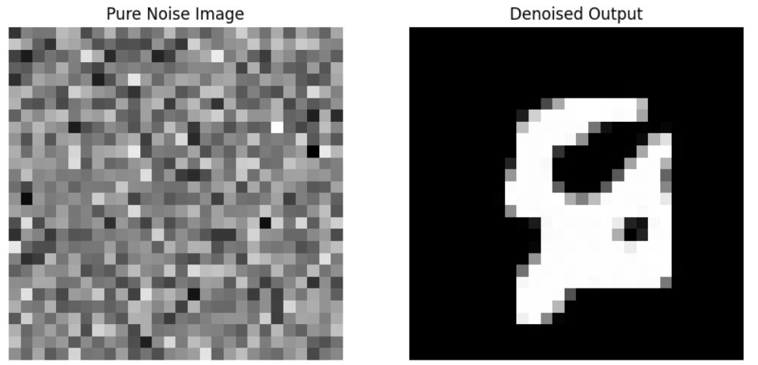
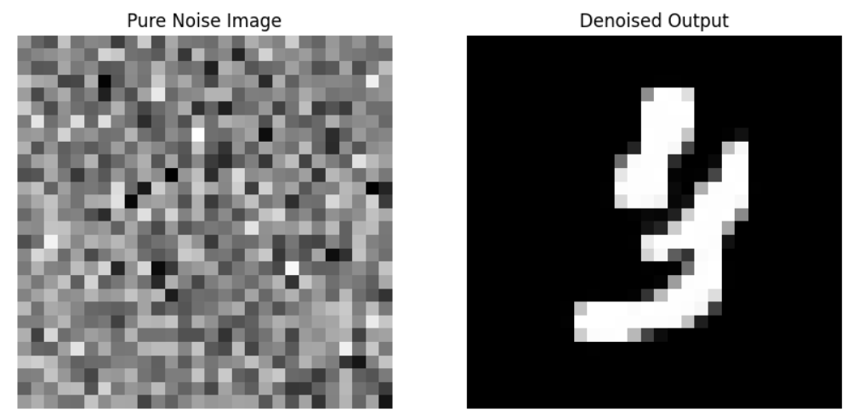
In practice, however…
What happens if we use the reverse diffusion process and our model on an image that is pure noise? Do we obtain an MNIST-like sample?
Meh… Sometimes yes, sometimes no.

Slide 45
In practice, however…
Clearly, we are not there yet!
There is a need for more advanced practices to training diffusion models efficiently.
Learn more in the Computer Vision course on Term 8!
(Or if you already want a pre-trained implementation, readily available…) https://github.com/VSehwag/minimal-diffusion

Slide 46
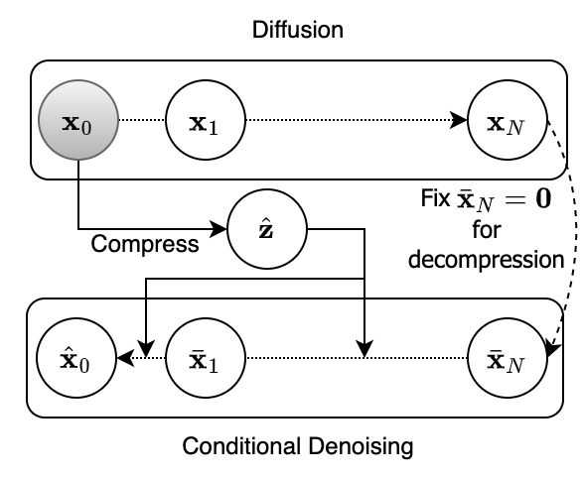
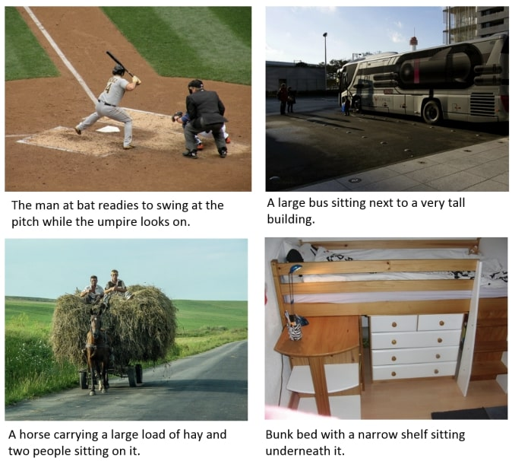
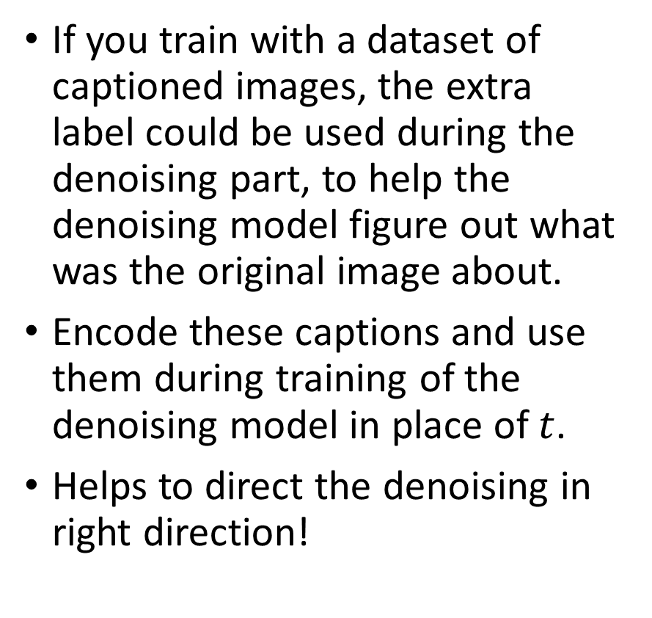
Making it conditional
If you train with a dataset of captioned images, the extra label could be used during the denoising part, to help the denoising model figure out what was the original image about.
Encode these captions and use them during training of the denoising model in place of $t$.
Helps to direct the denoising in right direction!

Slide 47
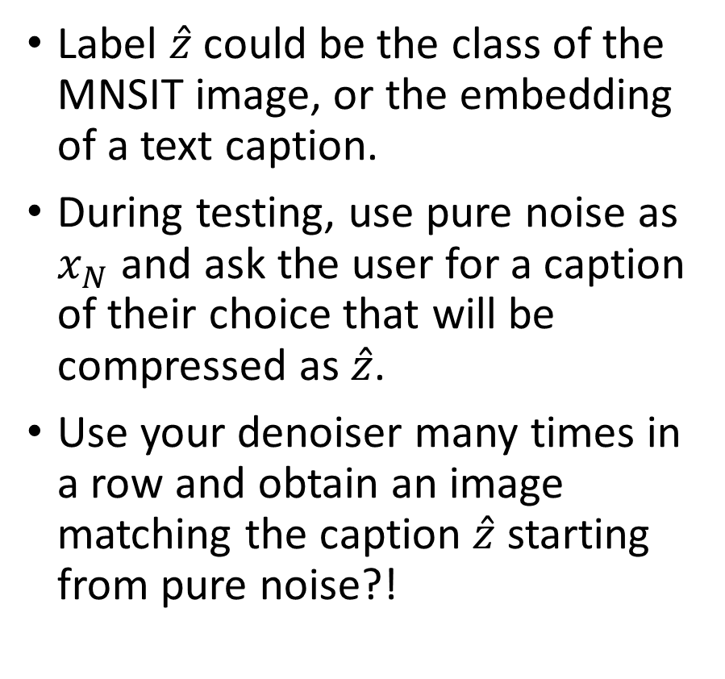
Making it conditional
Label $\hat{z}$could be the class of the MNSIT image, or the embedding of a text caption.
During testing, use pure noise as $x_{N}$ and ask the user for a caption of their choice that will be compressed as $\hat{z}$.
Use your denoiser many times in a row and obtain an image matching the caption $\hat{z}$ starting from pure noise?!

Slide 48
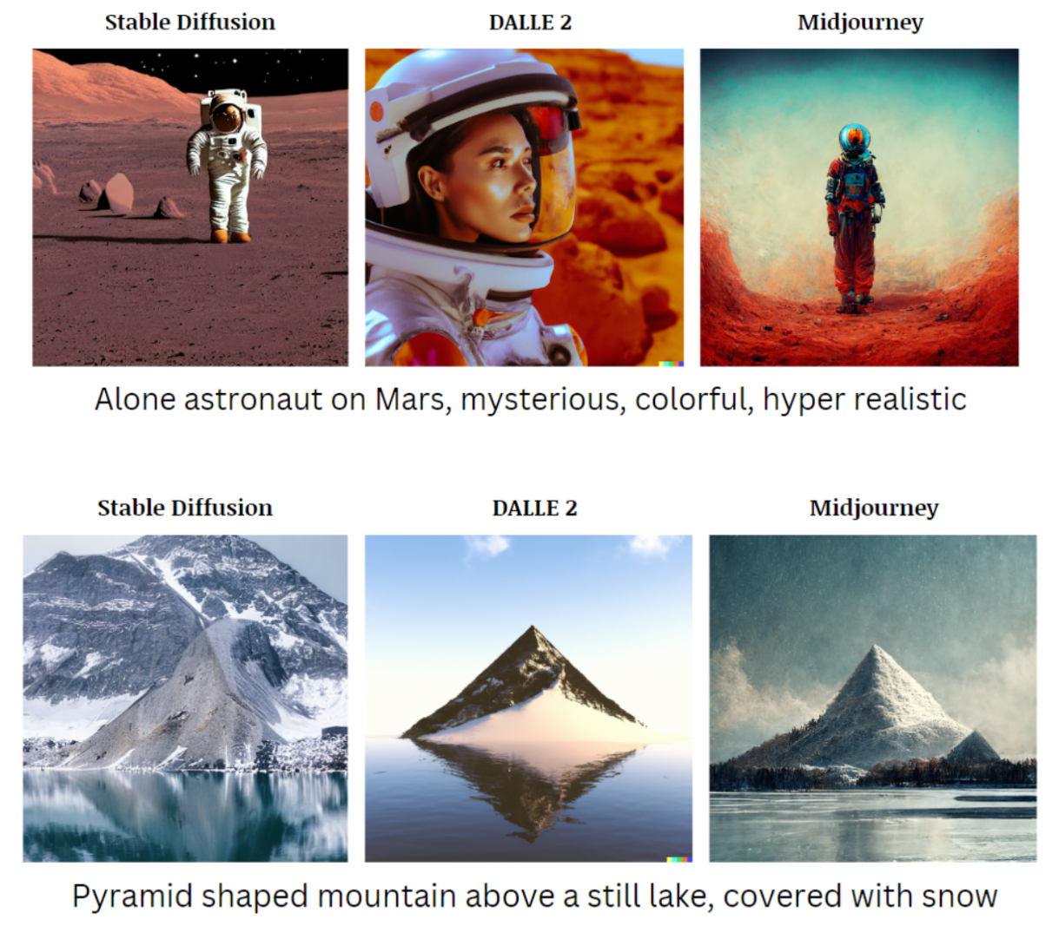
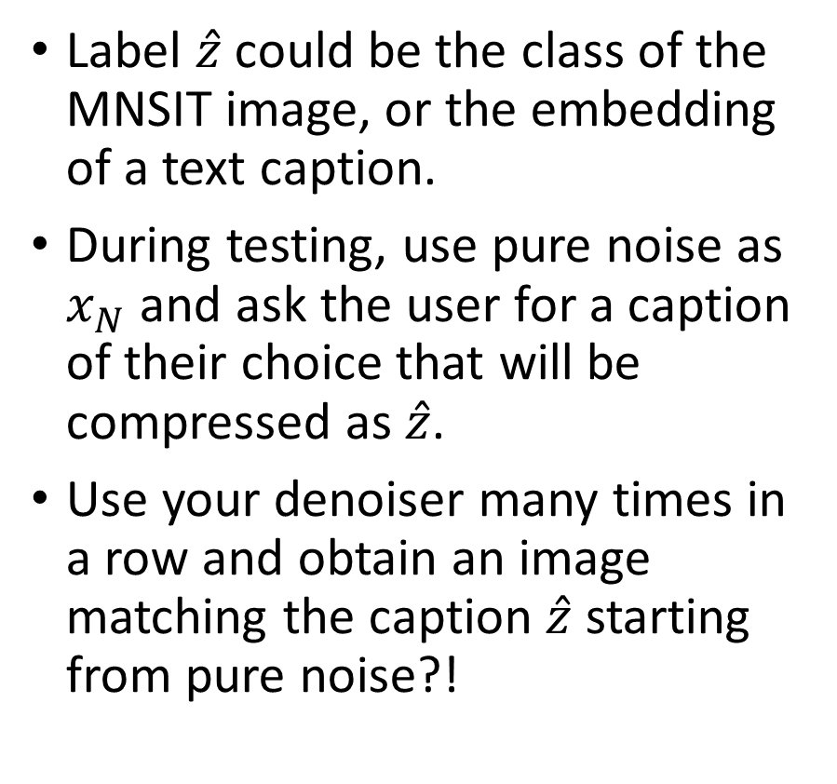
Making it conditional
Label $\hat{z}$could be the class of the MNSIT image, or the embedding of a text caption.
During testing, use pure noise as $x_{N}$ and ask the user for a caption of their choice that will be compressed as $\hat{z}$.
Use your denoiser many times in a row and obtain an image matching the caption $\hat{z}$ starting from pure noise?!

Slide 49
Diffusion: a good entry point to continue your study of generative models
What is “stable” diffusion then? The "stable" part of stable diffusion comes from optimizations that make the model more efficient and stable, particularly for large-scale text-to-image generation tasks.
While it would be impossible to explain the issues and stable diffusion in two minutes, know that it achieves this using latent diffusion, a key innovation, out-of-scope for this course (maybe CV course!).
Normal Diffusion Models: Operate directly in pixel space, which can be computationally expensive and slow for high-resolution images.
Stable Diffusion: Operates in a latent space (a compressed representation of the image), significantly reducing computational costs and making the process faster and more efficient.

Slide 50
Diffusion: a good entry point to continue your study of generative models
What is “stable” diffusion then? The "stable" part of stable diffusion comes from optimizations that make the model more efficient and stable, particularly for large-scale text-to-image generation tasks.
While it would be impossible to explain the issues and stable diffusion in two minutes, know that it achieves this using latent diffusion, a key innovation.
Normal Diffusion Models: Operate directly in pixel space, which can be computationally expensive and slow for high-resolution images.
Stable Diffusion: Operates in a latent space (a compressed representation of the image), significantly reducing computational costs and making the process faster and more efficient.
Something for later in the Term 8 Computer Vision course?

Slide 51
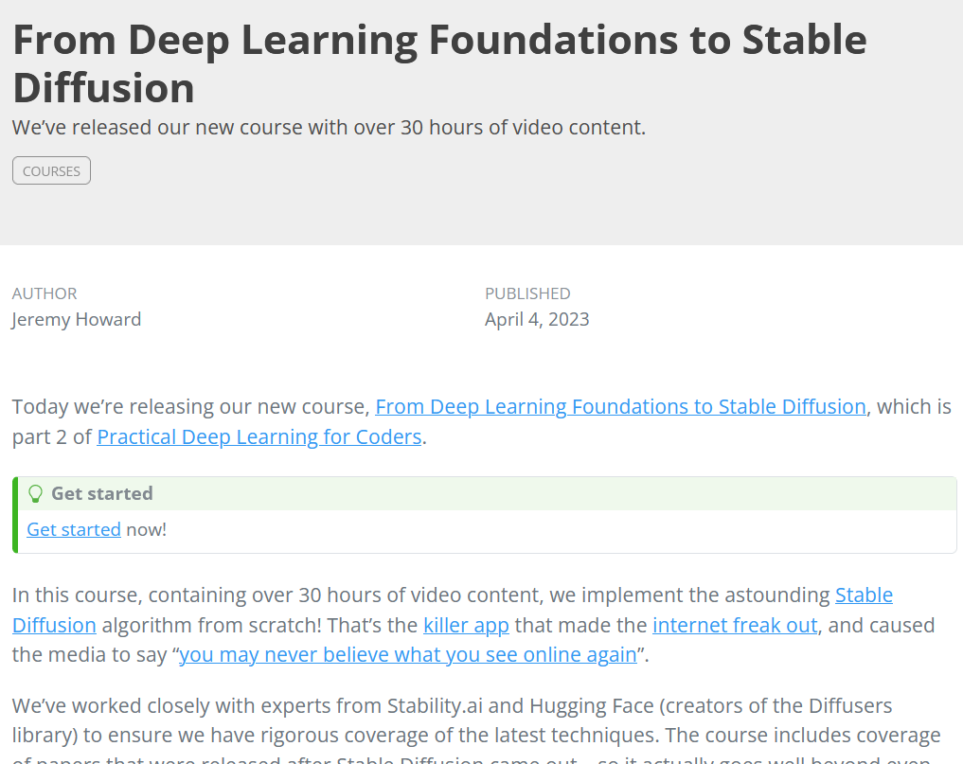
Diffusion: a good entry point to continue your study of generative models
If you cannot wait for the Term 8 Computer Vision course…
I guess, this course from Jeremy Howard (Fast.ai), one of the most important AI teachers out there, is probably very nice to take…
https://www.fast.ai/posts/part2-2023.html

Slide 52
Conclusion
What is a Stochastic Differential Equation?
What are typical uses of SDEs?
Can I noise images progressively using SDEs?
Can you train a denoising autoencoder model that removes SDE noise from images?
What is the diffusion process and how to use it to train diffusion models?
What are the architectures of DALL-E and Midjourney models?

Slide 53
Learn more about these topics
Out of class, for those of you who are curious
The one paper, usually cited for Diffusion models [Ho2020] J. Ho, X. Chen, A. Srinivas, Y. Duan, and P. Abbeel, “Denoising diffusion probabilistic models. Advances in Neural Information Processing Systems”, 2020. https://arxiv.org/abs/2006.11239
[Dhariwal2021] P. Dhariwal, and A. Nichol, “Diffusion models beat GANs on ImageNet.”, 2021. https://arxiv.org/abs/2105.05233

